Slide 1

CCLDAS Database Progress 10/11 Update

Slide 2
Status as of October 11th:
Database is working and can handle average dust event rates of around 7hz
Batch processor program that uses IDL code to reject false triggers update velocity, mass, charge, and radius estimates for real events is working
Database importer VI for old data is working
Updated and streamlined DAQ VI to replace the out of date version of Keith’s VI we are currently using is being built

Slide 3
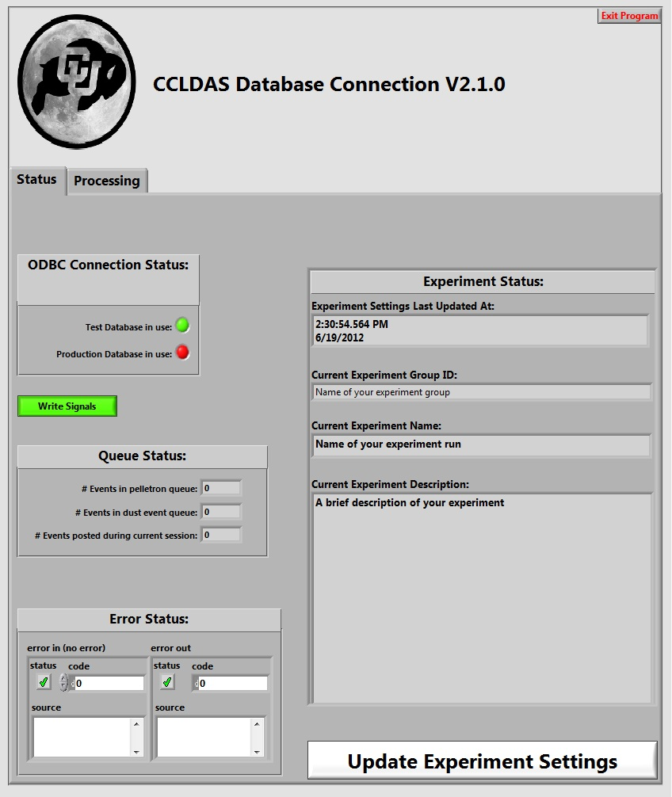
Proposed Guidelines for using database during pelletron operation
In order to collect machine and source performance data, please use the database even if you don’t plan on using it to collect scientific data
DB connection VI should run automatically anytime the DAQ VI is run
However, a quick check that the “# Events posted during current session” indicator is incrementing would be greatly appreciated and might be rewarded with donuts.*
*donuts not guaranteed.

Slide 4
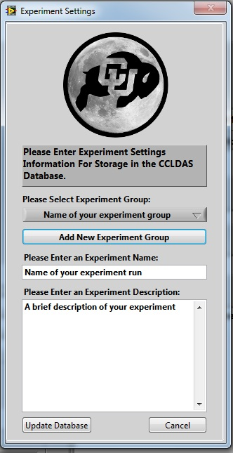
Proposed Guidelines for using database during pelletron operation (continued)
The main user interaction we would like from you is to click on the “Update Experiment Settings” button at the beginning of your run, and fill out the fields in the resulting pop-up.
If you also plan to use the LeCroy scope, double check that both the DB computer and the scope clocks are synchronized.

Slide 5
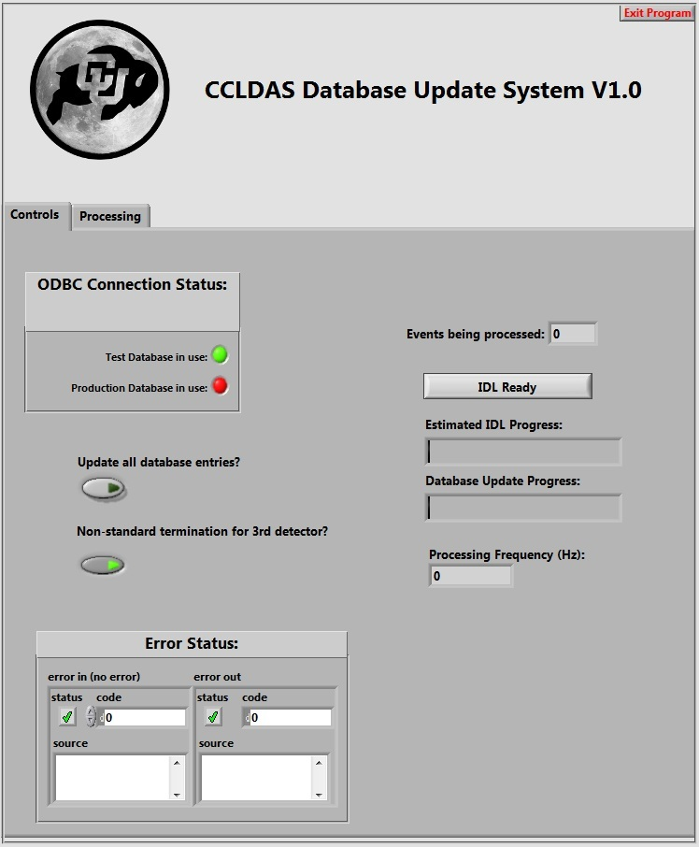
Batch Update VI usage
The batch update VI examines the waveforms recorded by the database and generates higher quality velocity, mass, charge and radius estimates.
To use, run batch processor.vi
No other input is needed.

Slide 6
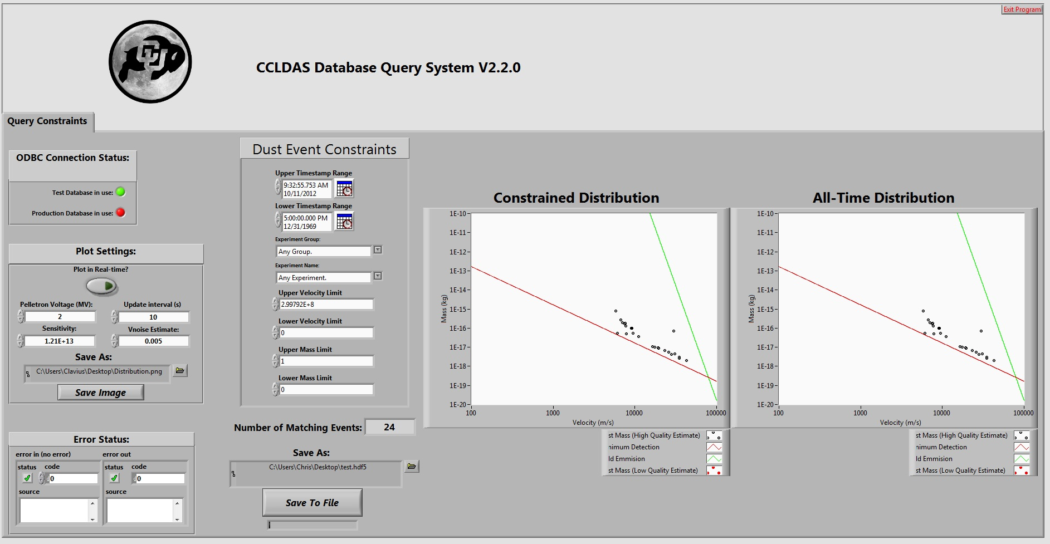
Query VI
The database query VI allows users to select datasets from the database based on time, experiment settings, mass, and velocity constraints.
This data is then written to a binary .hd5 file that can be opened in IDL
IDL programs to open these files are available on the server in: Z:\DatabaseProject\Public IDL Files

Slide 7
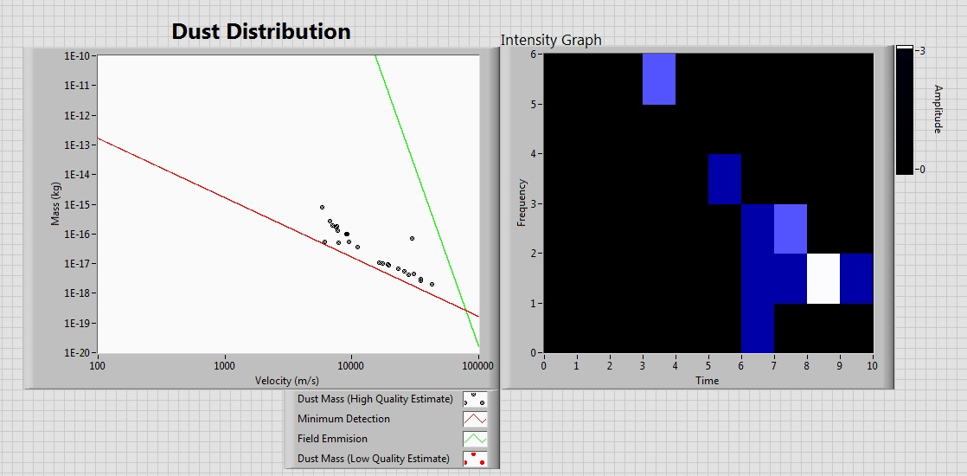
Questions?

Slide 8
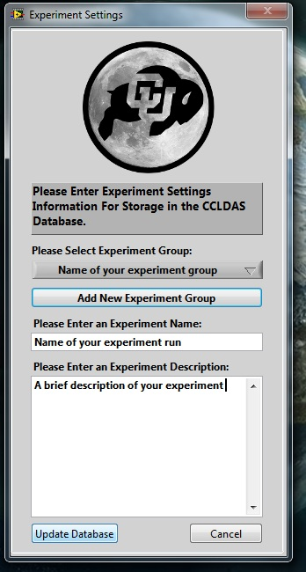
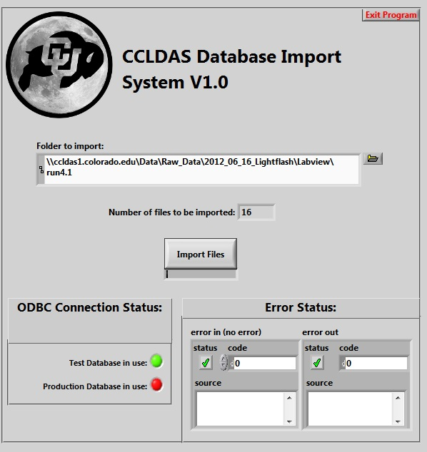
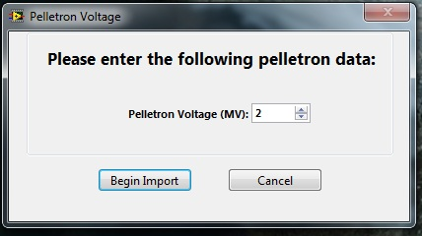
Bonus Slide! Database Importer
The database Importer VI allows old labview files to be imported into the database
To use, select a folder, click import files, then fill out the experiment settings pop-up and enter the pelletron voltage setting for the experiment

